Slide 1
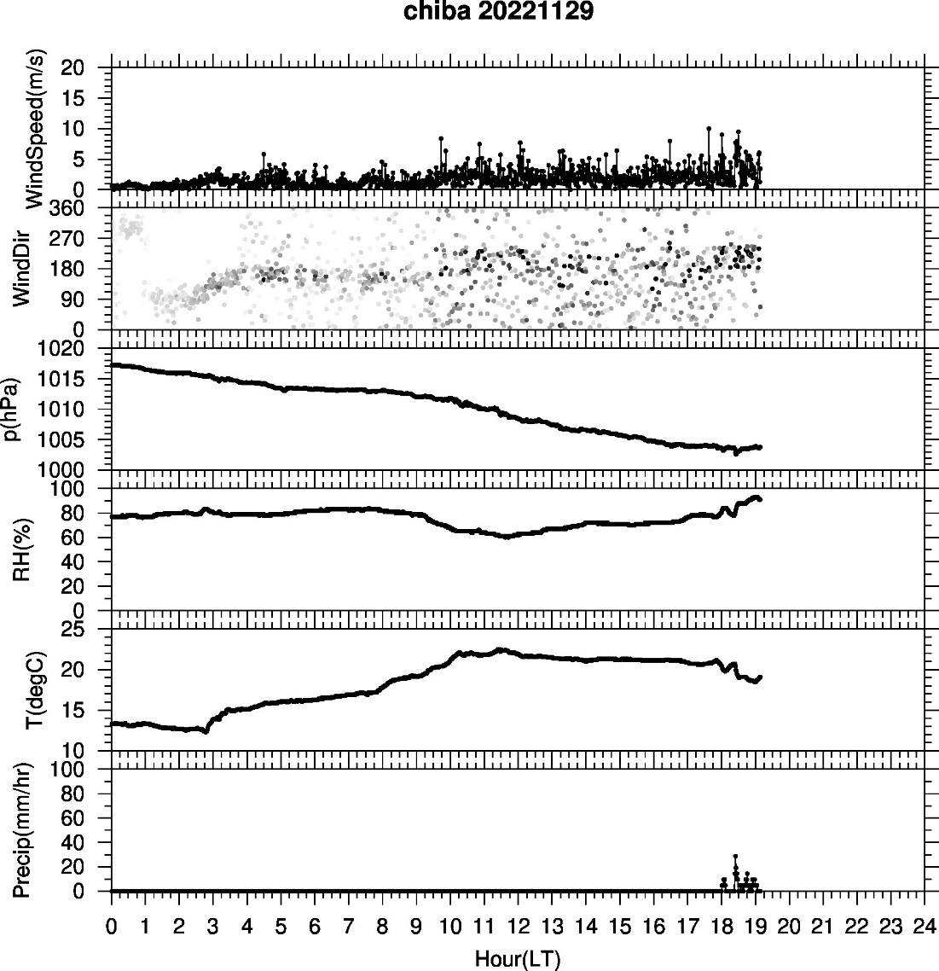
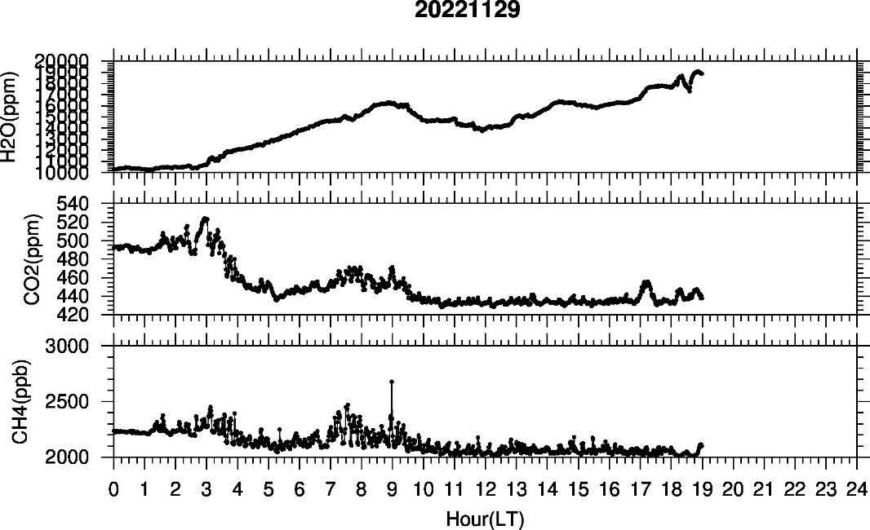
Met. para. and GHG data for 20221129

Slide 2
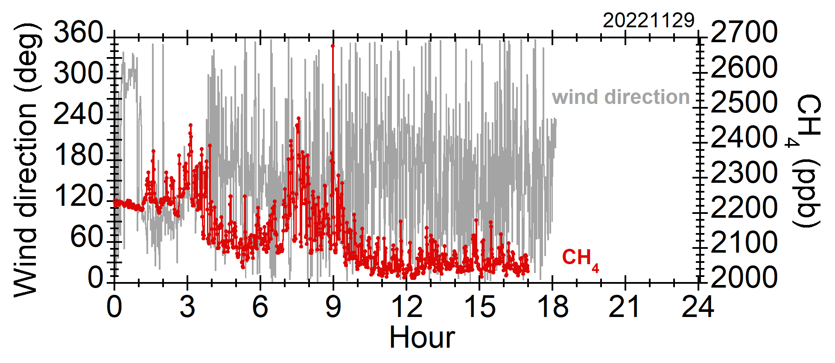
Time series of CH₄ and wind direction

Slide 3
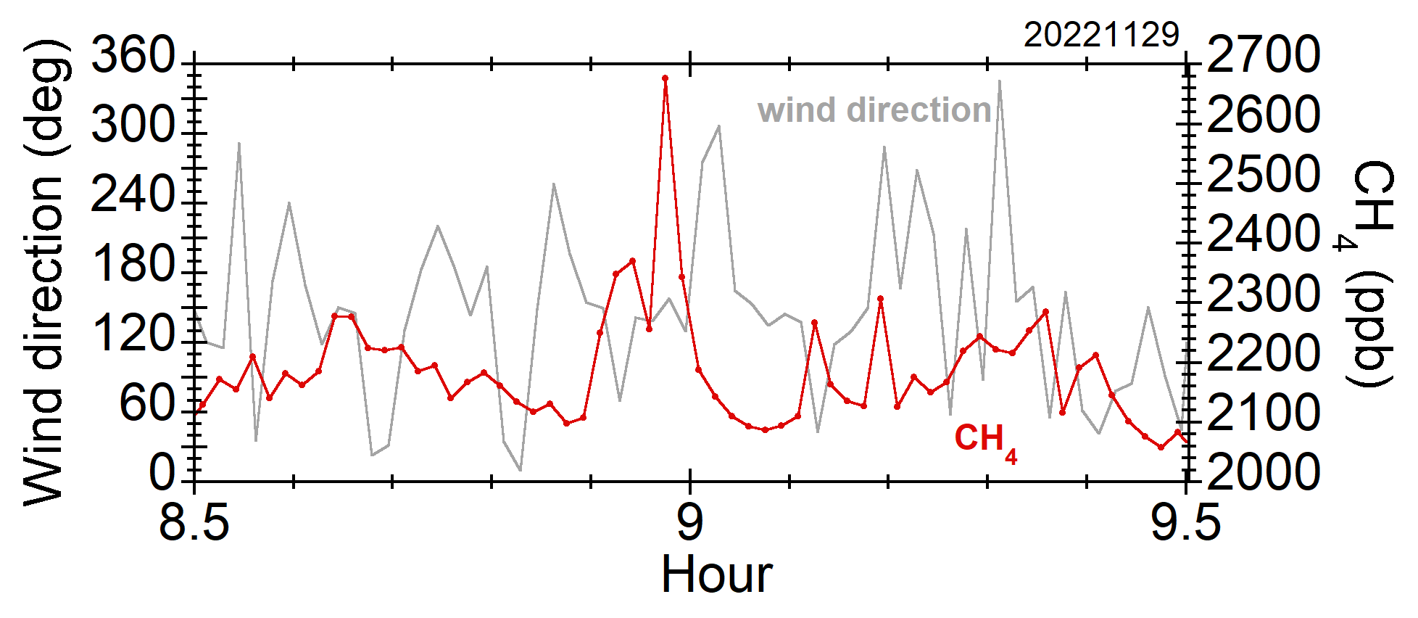
Abrupt increase in CH₄ around 9 o’clock

Slide 4
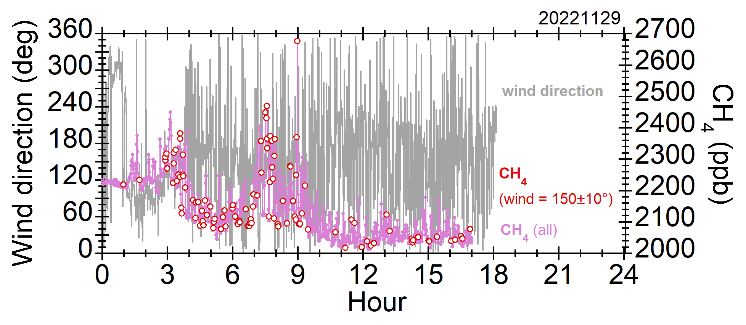
Potential increase in CH₄ concentration
at specific wind directions of 150º±10º

